Slide 1
Microbiology
INTRODUCTION TO MICROBIOLOGY

Slide 2
Reference books
Medical microbiology by:
Ernest Jawetz
Joseph Melnick
etc

Slide 3
2. Microorganisms in our world by:
Ronald M. Atlas
3. Microbiology, an introduction by: Tortora, Funke and Case.

Slide 4
Colour Atlas and Textbook of DIAGNOSTIC MICROBIOLOGY by:
Elmer Koneman
Stephen Allen
William Janda
et al.

Slide 5
Definition
Living things too small to be seen with unaided eye are called micro-organisms.
Forms of ‘life’ studied under microbiology are those which (mostly) cannot be seen without the aid of a microscope.

Slide 6
What is microbiology?
MICRO– means very small.
So small that it must be viewed with a microscope
BIO—means ‘life’ = ‘living organisms’.
OLOGY—means ‘the study of’
Study of life= microbiology

Slide 7
Therefore microbiology is the study of very small living organisms, mostly too small to be seen with unaided eye.

Slide 8
Forms of life studied in microbiology
These micro-organisms include the:
Bacteria
Algae
Protozoa (Unicellular Parasites)
Fungi
Viruses

Slide 9
Other names
These are often called
Microbes,
Single-celled organisms or Germs.
Only a small percentage of microbes are pathogenic.

Slide 10
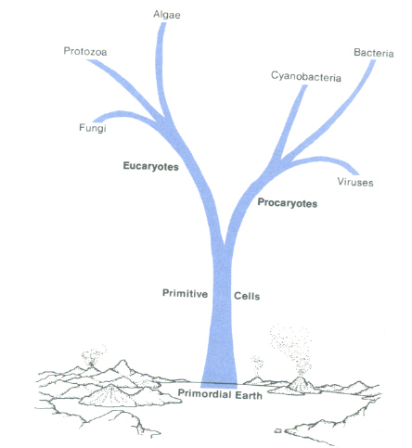
Family tree of micro-organisms

Slide 11
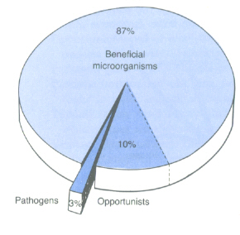
Pathogenicity of microbes

Slide 12
Procaryotes and Eucaryotes
Modern science has revealed that the first bit of life to appear on earth was a very primitive cell similar to the simple bacteria of today.
This occurred about 4 billion years ago.

Slide 13
These cells without defined nucleus and nuclear membrane are called procaryotes.

Slide 14
The more complex cells with a nucleus, nuclear membrane and many organelles are called eucaryotes or eucaryotic cells. These include the protozoa, fungi, algae, and all plants and animal cells.

Slide 15
Importance of microbes
Micro-organisms are important in the maintenance of an ecological balance on earth.

Slide 16
Some micro-organisms live in humans and other animals and needed to maintain the animal’s health.

Slide 17
Some micro-organisms are used to produce:
foods as in fermented foods eg: vinegar, cheese, yoghourt, bread.
chemicals eg :
acetone,organic acids, enzymes, alcohols.

Slide 18
Some micro-organisms cause diseases eg
Boils—Staphylococcus aureus
Diarrhoea as in food poisoning-- Bacillus cereus.
Measles---measles virus.
AIDS…HIV virus
Athlete’s foot --fungus
Guinea worm disease–guinea-worm parasite also called Dracunculus medinensis

Slide 19
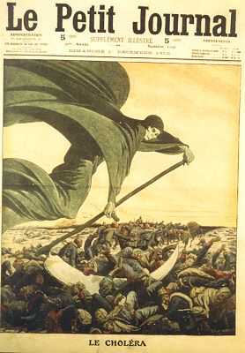
History of
Microbiology
Image: Drawing of Death Bringing Cholera in Le Petit Journal, circa 1912
From the Virtual Microbiology Classroom on ScienceProfOnline.com

Slide 20
A brief History of Microbiology
1st Fabrication of microscope was by a Dutch spectacle maker called Zacharias Jansen.
The 1st to employ microscope to examine biological materials extensively was Italian scientist called Marcello Malpighi (1628-1694) led to discovery of capillaries, & embryonic development. Marcello Malpighi –father of microscopic biology.
Notes:
Marcello Malphigi; father of microscopic microbiology

Slide 21
Robert Hook examined cork & observed that plant materials are composed of ‘little boxes’ which he called ‘cells’ (1665).

Slide 22
Anthony Van Leeuwenhoek (1632-1723)
Anthony Leeuwenhoek was the first to observe bacteria (micro-organisms) in 1673. He improved the light microscope and used it to observe the “little animals’. He called them “animacules”.
Notes:
Leeuwenhoek; first to observe bacteria

Slide 23
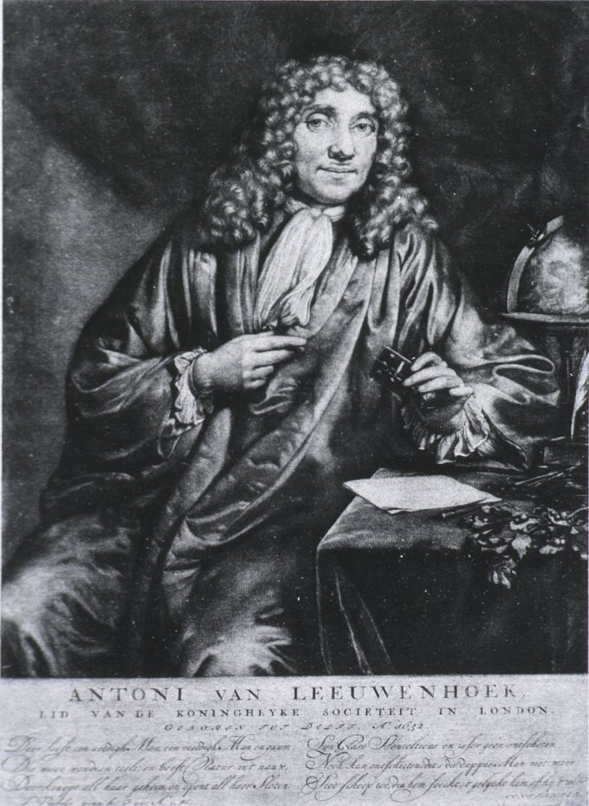

Slide 24
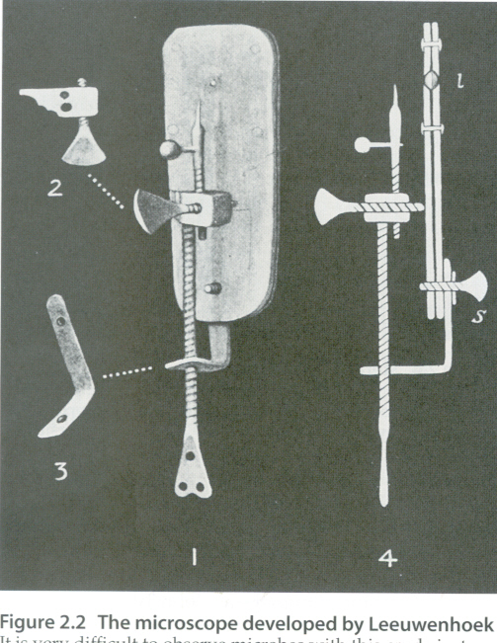
Leeuwenhoek’s microscope

Slide 25
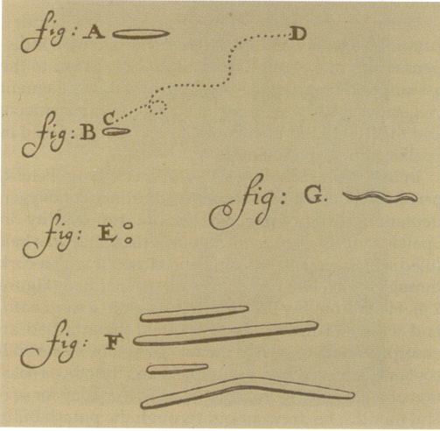
Leeuwenhoek’s drawings

Slide 26
He wrote many letters and described some of the bacterial forms now known.
He described their motility also.
He also described protozoa, spermatozoa, rbc, and he is generally referred to as the Father of protozoology and Histology.
Notes:
Anthony Hoek; father of protozoology

Slide 27
Spontaneous generation
Until 1880s people believed that living organisms could arise from non-living matter…spontaneous generation.
Maggots appear on decaying meat only after flies lay eggs on it…Fracisco Redi 1668.
Notes:
The theory of spontaneous generation was disproved by Francesco Redi though may have first been proposed by aristotle.

Slide 28
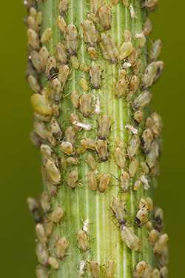
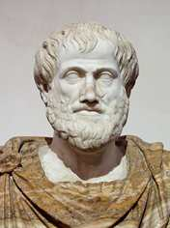
__________ __________ Debate
The belief in the spontaneous generation of life from nonliving matter was introduced by Aristotle, who lived around 350 BC.
According to Aristotle, it was:
“readily observable that aphids arise from the dew which falls on plants, fleas from putrid matter, mice from dirty hay.”
This belief remained unchallenged for more than 2000 years.
Until…
Aristotle: 384 – 322 B.C.
Images: Aphids, Flagstaff Fotos; Bust of Aristotle by Lysippus, Wiki
From the Virtual Microbiology Classroom on ScienceProfOnline.com
Notes:
Spontaneous Generation

Slide 29
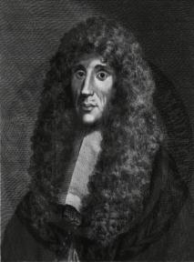
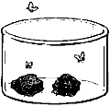
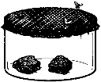
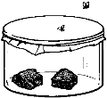
Spontaneous Generation Debate _____________ ________ - Experiments on Flies
First to formally challenge the accepted belief of spontaneous generation.
Redi's Question: Where do maggots come from? Hypothesis: Maggots come from flies. Experiment: Redi put meat into three separate jars.
Jar-1 Left open Maggots developed Flies were observed laying eggs on the meat in the open jar
Jar-2 Covered with netting Maggots appeared on the netting Flies were observed laying eggs on the netting
Jar-3 Sealed No maggots developed
Francesco Redi, Italian physician, naturalist & poet, 1626 – 1697.
Images: Redi’s experiment , Unknown; Fracesco Redi portrait. Wiki
Notes:
Francesco Redi

Slide 30
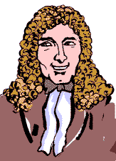
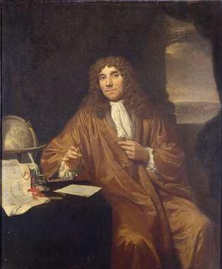
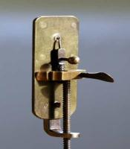
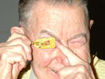
Spontaneous Generation Debate Anton van __ Leeuwenhoek _________: “Animalcules” (Pronounced Lay-when-hook)
As a tailor, used lenses to examine cloth. It was probably this that led to his interest in lens making.
He assembled hundreds of microscopes, some of which magnified objects 270 times.
As he looked at things with his microscopes, he discovered “micro” organisms - organisms so tiny that they were invisible to the naked eye.
He called these tiny living organisms “animalcules”. He first described bacteria and the protozoans.
1632 - 1723
Images: Leeuwenhoek portrait 1680, Jan Verkolje (I);. Replica of Leeuwenhoek microscope, Jacopo Werther; Man with scope, source unknown
From the Virtual Microbiology Classroom on ScienceProfOnline.com
Notes:
Leuwenhoek

Slide 31
John Needham (1745) claimed microoraganisms could arise spontaneouly from nutrient broth.
Lazzaro Spallazani (1765) repeated Needhams experiment and suggested that the microorganisms were from the air that entered the broth.

Slide 32
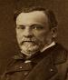
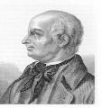
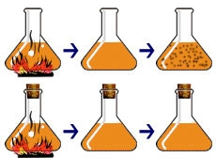
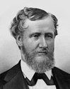
The Controversy Over Spontaneous Generation John Needham & Lazzaro Spallanzani
The Question:
What causes tiny living things to appear in decaying broth?
Needham’s Hypothesis: Spontaneous generation.
Spallazani’s Hypothesis: Microbes come from the air. Boiling will kill them.
French chemist Louis Pasteur’s design of this experiment settled the argument. Click here for an animation and quiz.
Needham >
1713 - 1781
Spallazani >
1729 - 1799
Image: Louis Pasteur, Pierre Lamy Petit circa 1866; Lazzaro Spallanzani, 1729-1799
From the Virtual Microbiology Classroom on ScienceProfOnline.com
Notes:
Experiment: Heat broth to kill all life within, then see if, after heat is removed, microbes reappear.
Needham and Spallanzani did almost identical experiments. However, there was one key difference that critically impacted their results. Needham didn’t cover his flasks, so material (including microbes) from the surrounding air could drift into his flasks. Spallanzani’s flasks were sealed. This difference in experimental design accounted for their opposing conclusions:
Needham: Life re-emerged due to spontaneous generation.
Spallanzani: Heat killed the microbes, and, since the flasks were sealed, microbes did not reappear.

Slide 33
Rudolf Virchow introduced the concept of biogenesis…(1858).
He argued that living cells could only arise from pre-existing living cells this is the concept of biogenesis.

Slide 34
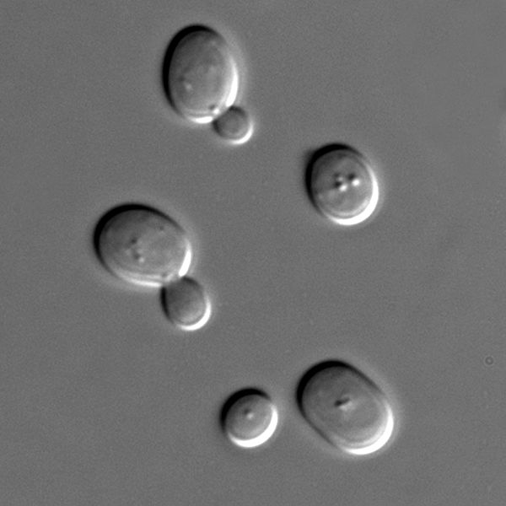
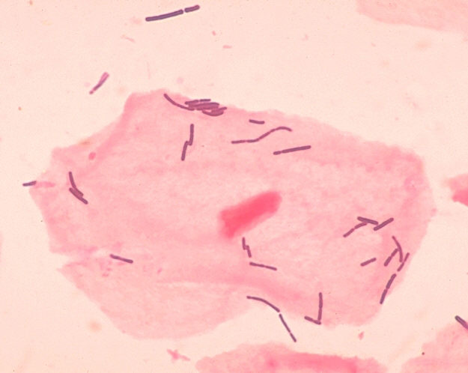
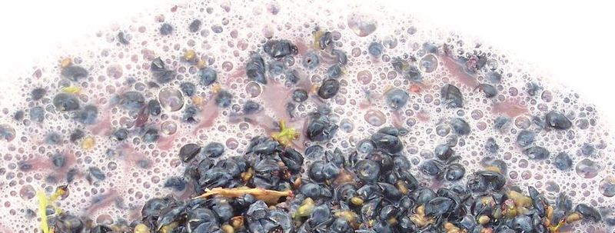
The Controversy Over Spontaneous Generation Louis Pasteur & Industrial Microbiology
Pasteur’s
Observations:
Blobs were alive because
they divide and make more of themselves.
2. Put grape juice + yeast in open and in air-tight containers. Fermentation occurred in both. This means that yeast are _________ _________.
3. Took two flasks of sterile grape juice and introduced bacteria into one and yeast into another.
- Q: What is fermentation?
- What causes fermentation?
Some scientists thought that air caused fermentation
Others thought that microbes caused fermentation.
- Q: What is pasteurization?
Are these non-living blobs or living microbes?
< yeast + grapes = yummy wine ☺ (ethanol)
bacteria + grapes = spoiled wine ☹ (lactic acid) >
Image: Louis Pasteur, Pierre Lamy Petit, circa 1866; Grapes fermenting; Sachromyces yeast; Lactobacillus, Public health Image Library #1048
From the Virtual Microbiology Classroom on ScienceProfOnline.com
Notes:
Fermentation = breakdown of sugar, resulting in either the waste product of ethanol or lactic acid
Pasteurization is the process of heating a food, usually a liquid, to a specific temperature for a certain amount of time, and then immediately cooling it. Slows spoilage due to microbial growth.
Facultative anaerobes

Slide 35
Louis Pasteur
Louis Pasteur performed expts to prove the biogenesis concept and to disprove the dogma of spontaneous generation.
Pasteur placed the nutrient broths in long necked flasks and bent the neck of one set.
After boiling and cooling, the broth in the bent necked flasks did not contaminate.

Slide 36
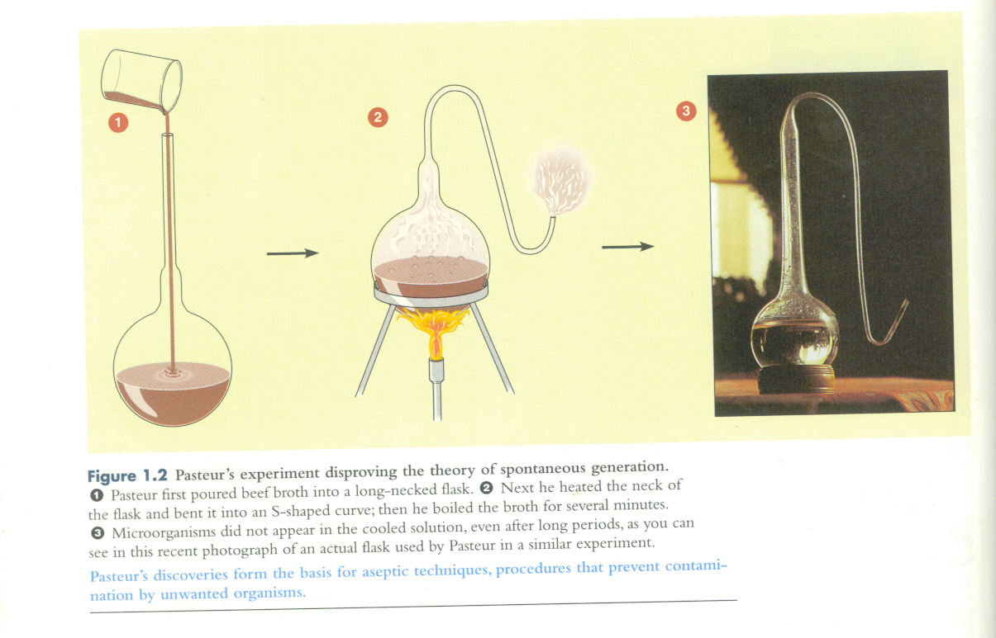
Pasteur's expt disproving the theory of spontaneous generation

Slide 37
Pasteurs work showed the ff:
1. Microorganisms can be present in nonliving matter.
2. Microbial life can be destroyed by heat.
3. Micro-organisms did not originate from nonliving solutions or from mystical forces.
These discoveries form the basis for aseptic techniques.

Slide 38
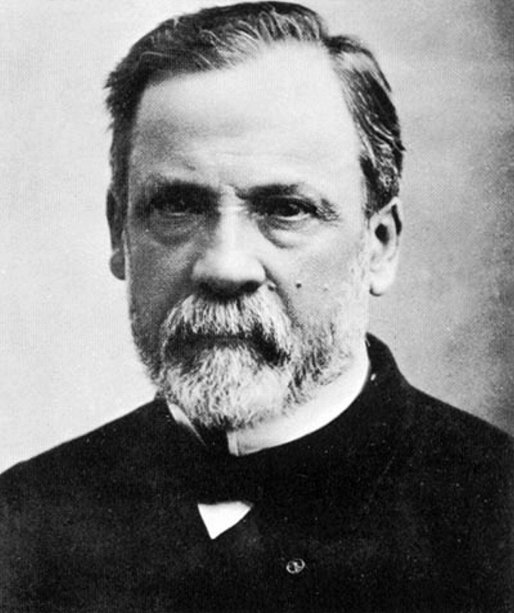
Louis Pasteur

Slide 39
The golden age of microbiology
Fermentation and pasteurization
Pasteur found that:
1. Yeast ferment sugars to alcohol and
2. bacteria, convert the alcohol to acetic acid.
…heating process kills bacteria in some alcoholic beverages and milk---this was called pasteurization.

Slide 40
Pasteur’s works
Ended the notion of spontaneous generation
Established immunology as a science – chicken cholera, rabies.
Established fermentation as a science
Established anaerobiosis
Aseptic techniques,& sterilization.
Application of microbiology to industry.
These works set the beginning for modern age of Microbiology

Slide 41
Aseptic technique is a method designed to prevent contamination from microorganisms. It involves applying the strictest rules and utilizing what is known about infection prevention to minimize the risks that you'll experience an infection

Slide 42
Which of the following does NOT apply to microorganisms?
A
Microorganisms participate in the carbon cycle and the nitrogen cycle.
B
ALL microorganisms are unicellular organisms.
C
Microorganisms are very diverse.
D
Microorganisms help recycle waste products through decomposition.

Slide 43
Spontaneous generation was a theory defined by:
A
Louis Pasteur
B
Aristotle
C
Robert Hooke
D
Francesco Redi

Slide 44
Which was the first bacterium shown to cause human disease?
A
anthrax
B
diphtheria
C
mycobacterium
D
streptococcus

Slide 45
Which of the following is mismatched?
A
Spallanzani: discovered that boiling broth will sterilize it by killing any microorganisms in it
B
Pasteur: developed the germ theory
C
Koch: developed a classification of bacteria into groups based on shape
D
Leeuwenhoek: one of the first to observe microorganisms through the microscope

Slide 46
The Germ Theory of disease
Pasteur’s work led to the realisation that micro-organisms could cause the physical and chemical changes in organic matter.
This led to the germ theory of disease.

Slide 47
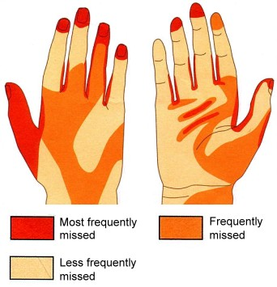
The Germ Theory of Disease Importance of Hand Washing
Sung to tune of "Row, row, row your boat."
Wash, wash, wash your hands,
Play our handy game.
Rub and scrub, scrub and rub,
Germs go down the drain.
(Sing 2x = about 20 seconds.)
Images: Hand washing diagram, used with permission © Clinical Skills Ltd
From the Virtual Microbiology Classroom on ScienceProfOnline.com
Notes:
Holmes
Semmelweis

Slide 48
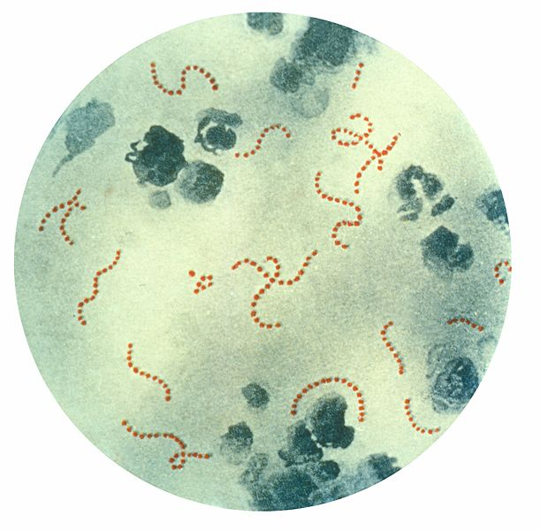
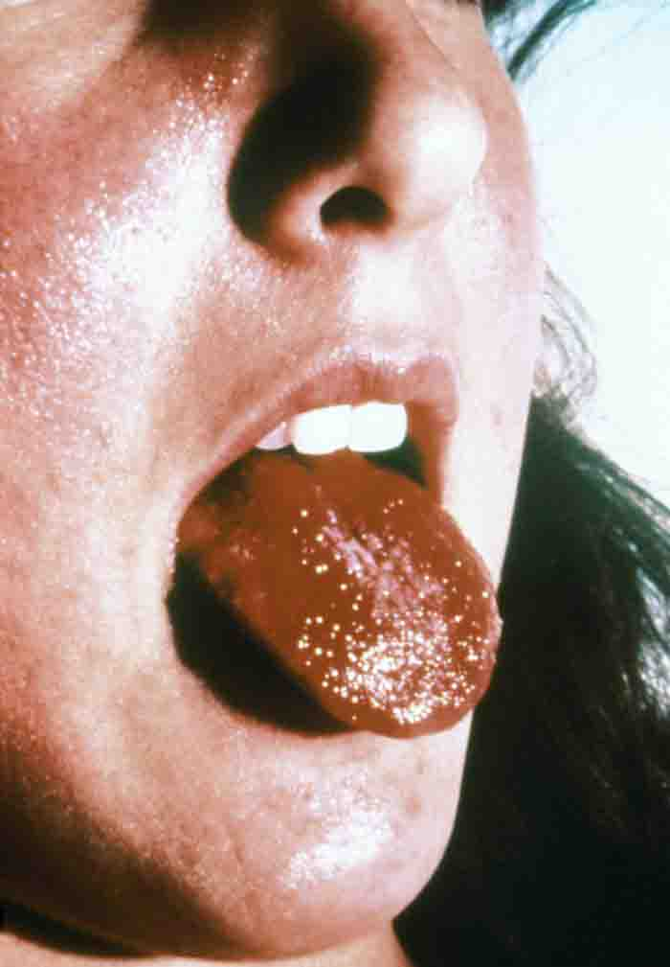
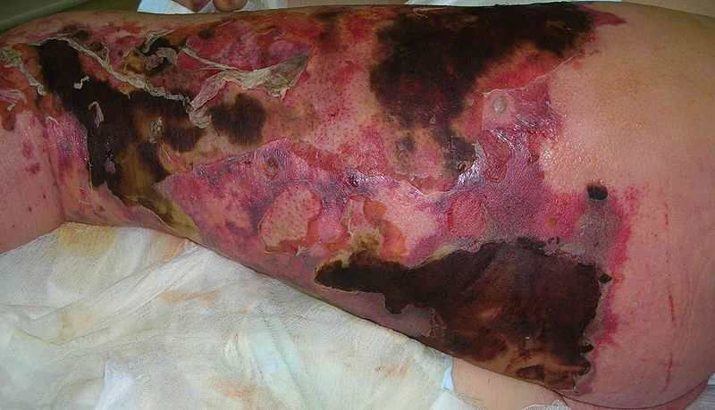
Meet the Microbe!
Organism: _______ ______
Streptococcal Infections
Streptococcus is a Gram + cocci-shaped genus of bacteria, which produce toxins that contributes to its pathogenesis.
Some diseases caused by this bacterium include:
Puerperal fever
Strep Throat
Streptococcal Pneumonia
Scarlet fever
Necrotizing fasciitis (flesh-eating bacteria)
Streptococcus
Images: Scarlet fever strawberry tongue Public Health Image Library (PHIL) # 5120; Streptococcus pyogenes, PHIL #2110; Necrotizing fasciitis, Smuszkiewicz, Trojanowska & Tomczak.
From the Virtual Microbiology Classroom on ScienceProfOnline.com
Notes:
Streptococcus pyogenes

Slide 49
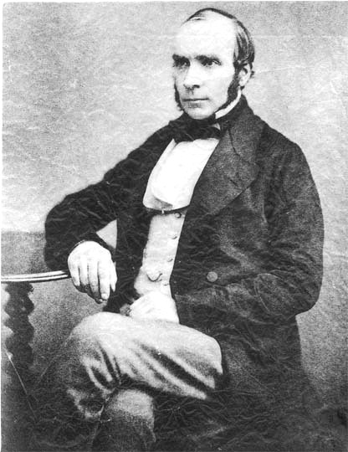
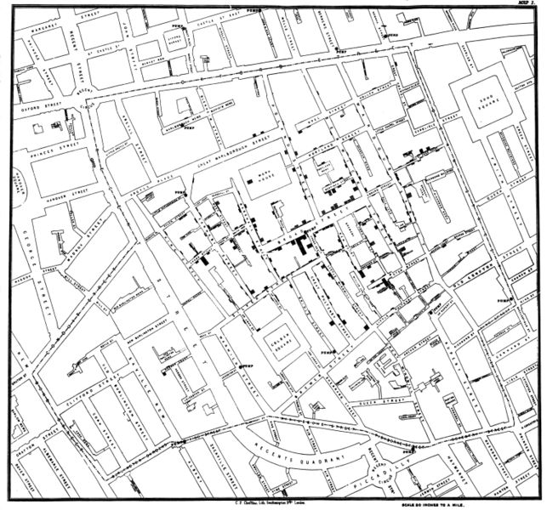
Germ Theory of Disease Dr. Snow_John______ : Investigation of __Cholera
1813 - 1858
Played key role in setting standards for good public hygiene and preventing spread of infectious disease.
Snow skeptic of the then-dominant “miasma theory” (disease caused by bad air).
Believed cholera transmitted by water contaminated with waste of other cholera sufferers.
Mapped occurrence of cholera cases during epidemic in London and found cases centered around a specific public water supply.
Asked city of London to dismantle the pump.
Q: What do you think happened once water pump was dismantled?
Images: Snow’s map of London, published by C.F. Cheffins, 1854;. John Snow, 1813-1858, Wiki
From the Virtual Microbiology Classroom on ScienceProfOnline.com
Notes:
John Snow
Cholera

Slide 50
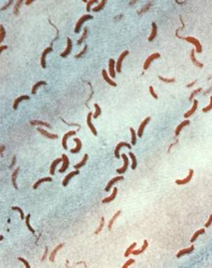
__________
Disease, Please!
• Infectious gastroenteritis caused by the Gram - bacterium Vibrio cholerae.
• Transmission occurs through ingesting contaminated water or food.
• Action on mucosal epithelium lining of the small intestine responsible for the characteristic massive diarrhea.
• One of the most rapidly fatal illnesses known.
Progresses from first liquid stool to shock in 4 to 12 hours, with death quickly following without rehydration treatment.
Read excerpt form “The Dress Lodger” p.114
Image: Drawing of Death Bringing Cholera in Le Petit Journal, circa 1912; Vibrio cholerae, PHIL #5324
From the Virtual Microbiology Classroom on ScienceProfOnline.com
Notes:
Cholera

Slide 51
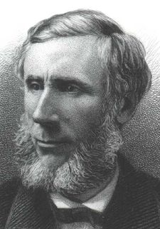
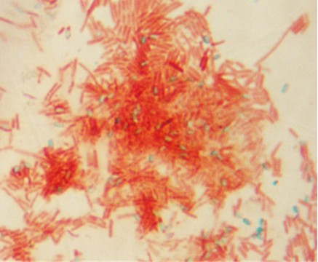
The Germ Theory of Disease Tyndal: Discovery of Tyndalization
Discovered that some bacteria existed in two forms:
1. heat-stable form (endospore)
2. heat-sensitive form (vegetative cell)
It Needs prolonged or intermittent heating to destroy the heat-stable endospores.
His research resulted in a method of sterilizing liquid by heating it to boiling point on successive days, referred to as Tyndallization.
Tyndallization is useful for sterilization of growth media in science classes and other situations where autoclaves not available for pressure sterilization.
1820 - 1893
Images: John Tyndall; , H.B. Hall N.Y. 1878; Endospore stain T. Port
From the Virtual Microbiology Classroom on ScienceProfOnline.com
Notes:
Tyndall
Endospores

Slide 52
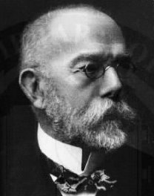
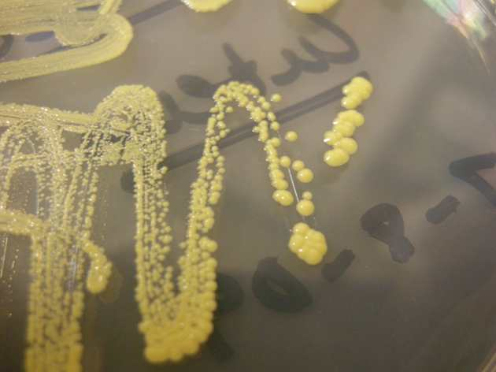
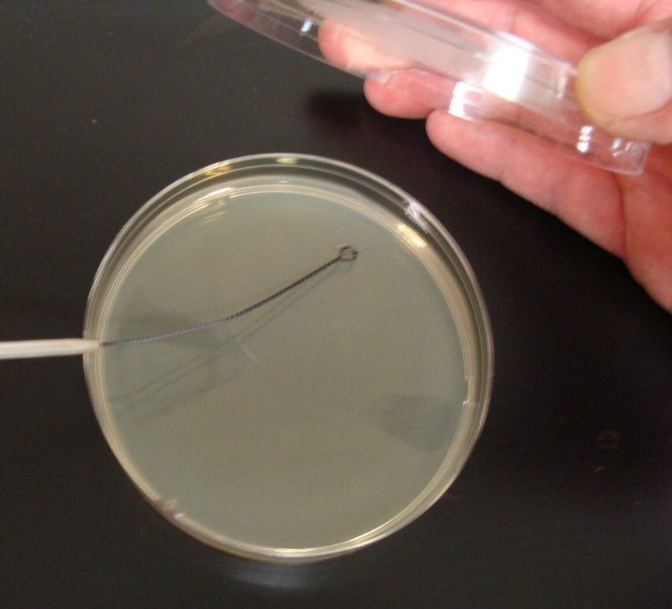
Germ Theory of Disease Robert ___Koch_____ Techniques
1843 - 1910
Experimented with medium to grow bacteria on.
He tried gelatin, but it did not work.
Wife of colleague recommended agar (a gelatin-like product derived from seaweed).
Didn’t melt, and bacteria couldn’t digest it.
He could also add various nutrients necessary to grow certain organisms.
Koch (pronounced Coke) originated use of a two part dish for growing bacteria (Petri_dish named after Julius Petri, a German bacteriologist), and a technique for isolating pure bacterial colonies.
From the Virtual Microbiology Classroom on ScienceProfOnline.com
Images. Micrococcus luteus colonies, T. Port; Robert Koch portrait, 1843-1910, NIH; MAC differential media, T. Port
Notes:
Koch
Petri dish

Slide 53
In the 1860s, Joseph Lister applied the germ theory to surgical procedures.
He was aware that Sommelweis (1840) demonstrated that physicians who went from patient to patient without disinfecting their hands transmitted puerperal fever to other patients.
Lister started treating surgical instruments and wounds with Phenol disinfectant.

Slide 54
Robert Koch was the first to establish the actual cause of disease.
He cultured blood from animals that died of anthrax. Prepared pure culture and Injected the culture into healthy animals. After the animals became sick and died he collected their blood for culture.
He found the organisms were the same.

Slide 55
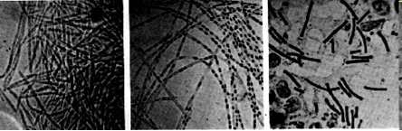
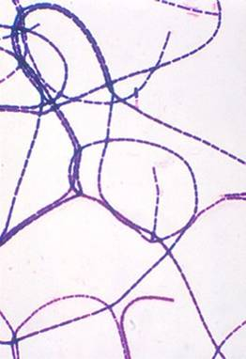
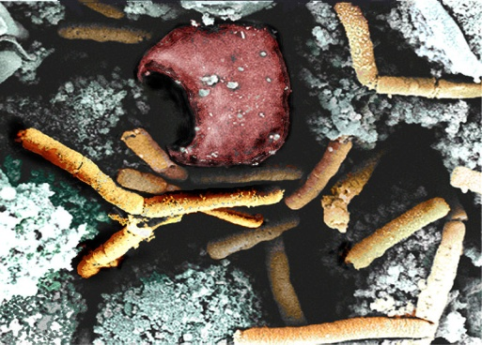
Disease, Please!
______________
Gram + Bacillus anthracis
An endospore-producing bacterium.
(Only the genera Bacillus & Clostridium
produce endospores.)
Bacillus anthracis first bacterium
proven to be the cause of a disease.
Anthrax was a disease killing European livestock. Farm animals, apparently healthy in the morning, might die by the end of the day, blood turned black.
Humans interacting with the animals were also at risk of becoming ill.
In 1877, Robert Koch grew Bacillus anthracis in pure culture, demonstrated its ability to form endospores, and produced experimental anthrax by injecting it into animals.
These experiments resulted in Koch formulating guidelines, called Koch’s __postulates____, for linking specific organisms with specific diseases.
For more information on Robert Koch, see “Robert Koch: History of Microbiology”.
Robert Koch's original micrographs of the anthrax bacillus.
From the Virtual Microbiology Classroom on ScienceProfOnline.com
Image: Gram stained Bacillus anthracis, ,Public Health Image Library #2105; Inhilation Anthrax in monkey spleen tissue, NIH.
Notes:
Anthrax
Postulates

Slide 56
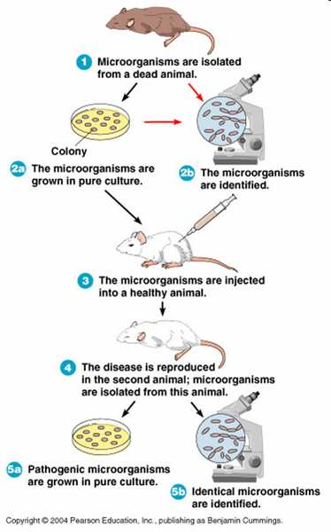
Germ Theory of Disease Koch’s Postulates
From the Virtual Microbiology Classroom on ScienceProfOnline.com

Slide 57
Koch formulated theories on the causal relationships between microbes and disease. From these theories came what is now known as Koch’s postulates.

Slide 58
Koch’s postulate…summary(1876)
1. the same pathogen must be present in every case of the disease.
2. the pathogen must be isolated from the diseased host and grown in pure culture.
3. the pathogen from the pure culture must cause the disease when it is inoculated into a healthy susceptible animal (host).
4. the pathogen must be isolated from the inoculated animal and must be shown to be the original pathogen.

Slide 59
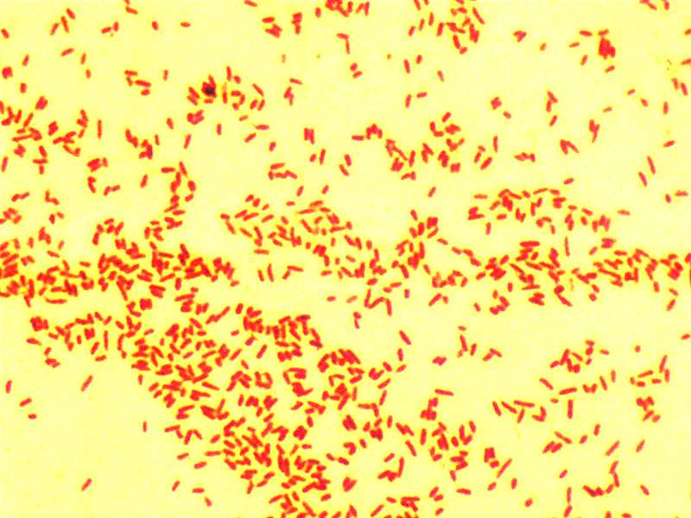
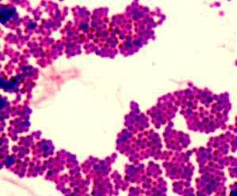
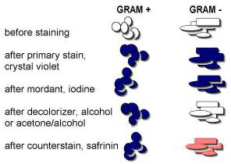
Germ Theory of Disease ______ ______
First of Koch’s postulates demands that the suspected agent must be found in every case of a given disease.
That means the tiny microbes must be seen and identified. However, in most cases, microbes are colorless and difficult to see.
Christian Gram (1850-1938) developed a technique, the Gram stain, that is still widely used today.
Differential stain that involves the application of a series of dyes.
Leaves some microbes purple and others pink.
Microbes that stain purple, Gram-positive, and those that stain pink, Gram-negative.
From the Virtual Microbiology Classroom on ScienceProfOnline.com
Images: Gram positive and Gram negative bacterial stains, T. Port
Notes:
Gram Stain

Slide 60
These postulates set the logical series of steps to be followed in the identification of microorganisms obtained from clinical specimens and the environment.
They are the steps to prove an organism to be a pathogen.

Slide 61
Exceptions to Koch’s postulate
No culture medium. Eg for .Treponema pallidum, Mycobacterium leprae.
One organism may produce diff types of disease.

Slide 62
Koch’s postulates have played an important role in microbiology, yet they have major limitations. For example, Koch was well aware that in the case of cholera, the causal agent, Vibrio cholerae, could be found in both sick and healthy people, invalidating his first postulate. Furthermore, viral diseases were not yet discovered when Koch formulated his postulates, and there are many viruses that do not cause illness in all infected individuals, a requirement of the first postulate.

Slide 63
Contradictions and occurrences such as these above have led many to believe that a fifth postulate may be required.
If enacted, this postulate would state that sufficient microbial data should allow scientists to treat, cure, or prevent the particular disease.

Slide 64
Nucleic acid-based methods make it possible to identify microbes that are associated with a disease, but in many cases the microbes are uncultivable. Also, nucleic acid-based detection methods are very sensitive, and they can often detect the very low levels of viruses that are found in healthy people without disease.

Slide 65
Fredricks and Relman postulates
The use of these new methods has led to revised versions of Koch’s postulates: Fredricks and Relman have suggested the following set of Koch’s postulates for the 21st century:

Slide 66
Fredricks-Relman’s postulates
A nucleic acid sequence belonging to a putative pathogen should be present in most cases of an infectious disease.
Microbial nucleic acids should be found preferentially in those organs or gross anatomic sites known to be diseased, and not in those organs that lack pathology. Fewer, or no, copies of pathogen-associated nucleic acid sequences should occur in hosts or tissues without disease.
With resolution of disease, the copy number of pathogen-associated nucleic acid sequences should decrease or become undetectable. With clinical relapse, the opposite should occur.

Slide 67
Fredricks –Relman postulates
4. When sequence detection predates disease, or sequence copy number correlates with severity of disease or pathology, the sequence-disease association is more likely to be a causal relationship
5. The nature of the microorganism inferred from the available sequence should be consistent with the known biological characteristics of that group of organisms.
6. Tissue-sequence correlates should be sought at the cellular level: efforts should be made to demonstrate specific in situ hybridization of microbial sequence to areas of tissue pathology and to visible microorganisms or to areas where microorganisms are presumed to be located.
7. These sequence-based forms of evidence for microbial causation should be reproducible

Slide 68
Edward Jenner used scrapings from cowpox and inoculated them into healthy human. The human developed mild disease but recovered.
Such people did not develop the severe smallpox.

Slide 69
Pasteur used avirulent form of bacteria to inoculate chicken against fowl cholera…he coined the word vaccine.
The process was called vaccination (vacca=cow) …in respect of Jenner’s work.
The protection given by vaccination is called immunity.

Slide 70
Vaccines are now produced from avirulent or killed forms of microorgansms.

Slide 71
Magic bullet dream: the birth of modern chemotherapy
Microbiologists later started looking for chemicals which could destroy the microorganisms.
Use of laboratory Chemicals for this purpose was called Chemotherapy.
The chemicals are called synthetic drugs

Slide 72
Chemicals produced naturally by bacteria or fungi to act against other microorganisms
are called antibiotics.

Slide 73
Paul Ehrlich (1910) looking for a magic bullet tested many lab chemicals against bacteria.
He found arsenic derivatives to be effective against syphilis.
He called the drug salvarsan

Slide 74
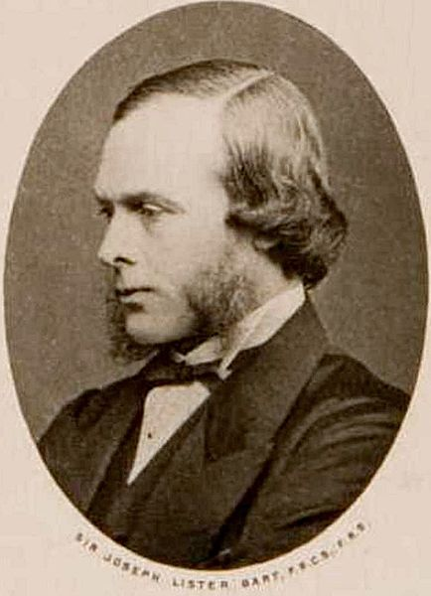
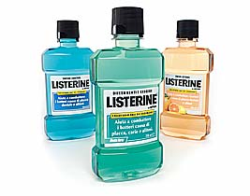
The Germ Theory of Disease Joseph _Lister_ – Father of Modern Antisepsis
Prevailing belief = Wound infection due to tissue
exposed to stinking "miasma" in air.
Lister had read a paper by Pasteur showing that rotting could occur without
oxygen if microorganisms present.
Maybe microorganisms were causing gangrene?
Pasteur suggested three methods to get rid of microorganisms:
________________________________
2. ________________________________
________________________________
The first two inappropriate for use in human wounds, so Lister experimented with the third.
Carbolic acid was used for deodorizing sewage, so Lister tried spraying instruments, surgical incisions, wounds and dressings with solution.
It markedly reduced the incidence of gangrene.
As germ theory became more widely accepted, understood infection best avoided by preventing bacteria from getting into wounds in the first place. This led to the rise of sterile surgery.
1827 - 1912
From the Virtual Microbiology Classroom on ScienceProfOnline.com
Image: Joseph Lister, circa 1860, Wiki
Notes:
Lister
1. Heat microbes up.
2. Filter microbes out.
3.Expose microbes to chemicals.

Slide 75
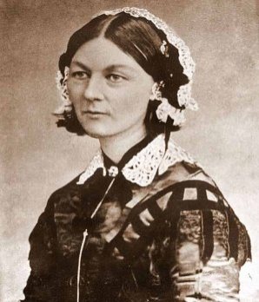
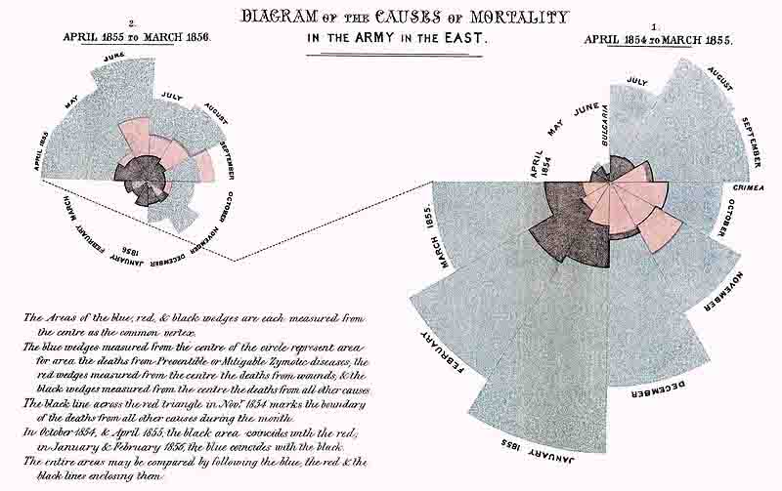
The Germ Theory of Disease _______ ___________ and __________
English nurse who was a proponent of cleanliness and antiseptic techniques to the field of nursing.
She came to prominence for her pioneering work in nursing during the Crimean War (say cry-me-in), where she tended to wounded soldiers.
She was meticulous about collecting and analyzing data on her practices, to provide proof of their efficacy.
Founded the Nightingale School for Nurses, the first nursing school in the world.
1820 - 1910
From the Virtual Microbiology Classroom on ScienceProfOnline.com
Image: Florence Nightingale from Carte de Visite, circa 1850; Polar area diagram by Florence Nightingale 1858.
Notes:
Florence Nightingale
Nursing

Slide 76
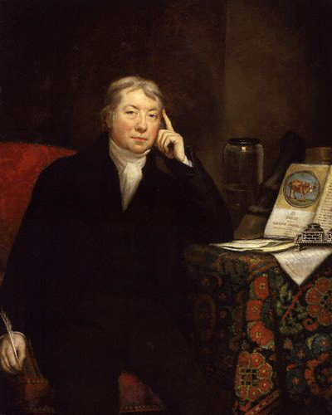
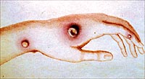

Early History of Immunology _____________ and the first _______
1749 - 1823
Was aware of farm workers' belief that if you had cowpox in past, you wouldn’t get smallpox.
Cowpox caused mild discomfort, aching, a few pustules, some swelling…symptoms that disappeared in a few days.
In contrast, smallpox caused massive disfigurement, sometimes blindness, and often death.
Jenner, in the late 1700s, made small incisions or punctures with cowpox material in arms of human subjects in order to prevent smallpox.
At first his peers doubted the safety and efficacy of his treatment, but eventually the value of the cowpox inoculum was recognized.
Jenner’s works are said to have saved more lives than the efforts of any other person in history.
From the Virtual Microbiology Classroom on ScienceProfOnline.com
Images: Dr. Edward Jenner by James Northcote; Child with Smallpox, James Hicks, CDC
Notes:
Edward Jenner
Vaccine

Slide 77



Early History of Immunology Pasteur’s _________ __________
Individuals who recover from an infectious disease sometimes immune from future attack.
Prompted Pasteur to try to find a way to prevent fowl cholera in chickens.
Colleague of Pasteur’s postponed inoculations of cholera into a group of chickens, a remarkable discovery resulted.
Inoculation with these neglected cultures made the chickens immune to fowl cholera.
The microbes had been weakened or attenuated.
Pasteur also modified other organisms (anthrax and the virus causing rabies).
Ultimately created inoculation procedures … vaccinations.
1822 - 1895
Image: Louis Pasteur, Pierre Lamy Petit, Frenchcirca 1866, Boy being vaccinated, PHIL #9364.
From the Virtual Microbiology Classroom on ScienceProfOnline.com
Notes:
Attenuated vaccines

Slide 78


Discovery of Antimicrobial Agents ______ ______
Dr. Gerhard Domagk (say Doe-mock), a German chemist who discovered that the dye Prontosil was effective against a wide range of bacteria.
Won the 1939, Nobel Prize in Medicine.
Sulfanilamide portion of the Prontosil molecule is responsible for its antibacterial effect (sulfonamides = sulfa drugs).
1895 - 1964
From the Virtual Microbiology Classroom on ScienceProfOnline.com
Images: Dr. Gerhard Domagk, 1964, Wiki, Sulfanilamide elixer, Source unknown
Notes:
Sulfa Drugs

Slide 79
A fortunate accident--Antibiotics
Alexander Fleming discovered that moulds growing on culture plates produced chemicals that inhibited bacterial growth.
The mould was identified to be penicillium notatum
The chemical was identified and called penicillin

Slide 80



Discovery of Antimicrobial Agents _________
Alexander Fleming (1881 – 1955), a Scottish biologist and pharmacologist, observed bacterial staphylococci colonies disappearing on plates contaminated with mold.
Fleming extracted the compound from the mold responsible for destruction of the bacterial colonies.
The product of the mold was named penicillin, after the Penicillium mold from which it was derived.
Nobel Prize in Physiology of Medicine in 1945.
Images: Penicillium mold, PHIL #8396; Staphylococcus aureus on antibiotic test plate, PHIL #2641; Poster attached to a mailbox offering advice to World War II servicemen, 1944, NIH
From the Virtual Microbiology Classroom on ScienceProfOnline.com
Notes:
Penicillin

Slide 81
Later a French microbiologist discovered Gramicidin and tyrocidine…both were produced by Bacillus brevis.

Slide 82
These developments laid down the ground work for the golden age of microbiology leading to monumental achievements in: Bacteriology,
Mycology and
Parasitology.
Later new areas in Immunology and Virology developed.

Slide 83
Just recently new methods called recombinant DNA technology was developed which has revolutionized research and practical application in all areas of microbiology.

Slide 84

Biopreparedness
M1 Infectious Diseases Sequence
Sandro Cinti

Slide 85
License:
Unless otherwise noted, this material is made available under the terms of the Creative Commons Attribution – Share Alike 3.0 License:
http://creativecommons.org/licenses/by-sa/3.0

Slide 86



Stadium: 1000Faces, wikimedia commons
Airplane: Gautherie, wikimedia commons

Slide 87
What is Bioterrorism?

Slide 88
Bioterrorism is the malevolent use of viruses, bacteria, fungi or toxins to produce death or disease in humans, animals or plants.

Slide 89
Any Examples of Bioterrorism?

Slide 90


1360 – Plague victims’ bodies thrown over besieged city’s walls
1763 – Europeans give smallpox infected blankets to Native Americans
1984 – Bhagwan Shree Rajneesh contaminates food with Salmonella to win election
1994 – Shoko Assahara group attack Tokyo subway with sarin gas
2001 – Anthrax

Slide 91
Why use biological weapons?

Slide 92
Why Use Biological Weapons?
Cheap-800 X less than nucs
Easy to acquire
Dual use
Web-based information
High Fatality
100 kg anthrax could kill 3 million (OTA report, 1993)
High Panic factor

Slide 93
What makes a good bioweapon?

Slide 94

USDA, HHS

Slide 95
Category “A” Biological Agents
Variola major (Smallpox)
Bacillus anthracis (Anthrax)
Yersinia pestis (Plague)
Francisella tularensis (Tularemia)
Botulinum toxin (Botulism)
Filoviruses and Arenaviruses (Viral hemorrhagic fevers)
Notes:
The CDC has developed a list of agents of highest biological concern. The agents of highest priority for public health preparedness efforts are:
Variola major (smallpox)
Bacillus anthracis (anthrax)
Yersinia pestis (plague)
Fransicella tularensis (tularemia)
Coxiella burnetii ( Q Fever)
Botulinum toxin (botulism)
and Viral Hemorrhagic Fevers due to Filo and Arenaviruses
All suspected or confirmed illness due to these organisms should be reported to health authorities immediately

Slide 96





Anthrax- Bacillus anthracis
Cutaneous
Gastrointestinal
Inhalational
Usafe.af.mil
Sources Undetermined (All other images)

Slide 97
Anthrax
Spore former
Not transmissible person-person
Inhalational-high mortality (50-90%)
2-3 IV antibiotics
Prophylaxis- ciprofloxacin, doxycycline-60 days

Slide 98



Tularemia
CDC
Source Undetermined
Cutaneous
G(-) Coccobacillus
1-2 organisms can cause infection
Not person-person spread
Tx-aminoglycosides, cipro, doxycycline
Cornell University Medical College

Slide 99


Botulinum Toxin
Made by the bacterium Clostridium botulinum
Most toxic substance on earth - food poisoning ( 0.1 ug lethal dose)
Weaponizable and aerosolizable (air & food supplies)
BoTox also used to medically, anti-wrinkle
Secreted protein neurotoxin causing flaccid paralysis
Death due to asphyxiation
Image of Botox injection removed
Image available here: www.stylelist.com/blog/tag/anti-aging/
C. botulinum
Cosmetic improvements are NOT bioterrorism
Source Undetermined

Slide 100


Hemorrhagic Viruses
Ebola, Marburg, Yellow Fever, Lassa
Viral syndrome with hemorrhagic complications
High fatalities with Ebola (80%)
No treatments, few vaccines (YF)
Person-person spread
Dr. Lyle Conrad, Joel G. Breman, CDC PHIL #7201
Source Undetermined

Slide 101




Plague-Yersinia pestis
Source Undetermined
World Health Organization,
CDC PHIL #463
CDC PHIL #2047
Bubonic
Source Undetermined

Slide 102


Septicemic Plague
Source Undetermined
Source Undetermined

Slide 103

Pneumonic Plague
Most likely form in BT
Mortality 80-90%
Person-person transmission
Tx- Streptomycin, IV ciprofloxicin or doxycycline
Prophylaxis- oral cipro or doxy
Source Undetermined

Slide 104
How would BT agents be disseminated?

Slide 105
Food
Water
Zoonotic
Aerosol

Slide 106
How would a BT attack be detected?

Slide 107
Clues to a BT Attack
A large number of ill persons presenting at the same time with a similar disease, especially the following syndromes:
Flaccid paralysis (botulinum toxin)
Hemorrhagic fevers (Ebola, Lassa fever)
Vesicular/pustular rash with considerable mortality (smallpox)
Influenza-like illness associated with a widened mediastinum on chest X-ray and/or meningitis (anthrax)
Pneumonia with painful lymphadenopathy (plague)

Slide 108
Clues to a BT Attack
Illness in animals and humans concurrently
A large number of unexplained deaths, especially in young healthy adults
A single case of an uncommon organism (e.g., smallpox, pulmonary anthrax, Ebola)
Multiple disease entities presenting in one patient
An unusual disease presentation (e.g., pneumonic instead of bubonic plague)

Slide 109
Clues to a BT Attack
An unusual geographic distribution (e.g., Ebola in the U.S.)
An unusual seasonal pattern (e.g., influenza in summer)
An illness that fails to respond to usual antimicrobials or vaccines (e.g., engineered antibiotic/vaccine resistant anthrax)
Clusters of a similar illness in non-contiguous areas, domestic or foreign

Slide 110

Source Undetermined

Slide 111

World Health Organization

Slide 112
Smallpox: Clinical Features
Prodrome (incubation 7-17 days)
Acute onset of fever, malaise, headache, backache, vomiting, occasional delirium
Transient erythematous rash
Exanthem
Begins face, hands, forearms
Spread to lower extremities then trunk over ~ 7 days
Synchronous progression: macules --> vesicles --> pustules --> scabs
Lesions on palms /soles
USAMRICD
Notes:
At the end of the incubation period the patient typically experiences high fever, malaise and prostration with headache and backache. Severe abdominal pain and delirium are sometimes present. A maculopapular rash then appears on the mucosa of the mouth and pharynx, face and forearms and spreads to the trunk and legs. Within 1 to 2 days, the rash becomes vesicular and, later, pustular. The pustules are characteristically round, tense, and deeply embedded in the dermis; crusts begin to form on about the eighth or ninth day.
[Picture of prominent lesions on face at later stage of illness]

Slide 113
SMALLPOX
CHICKENPOX
FEVER
2–4 days before the rash
At time of rash
RASH
Appearance
Pocks at same stage
Pocks in several stages
Development
Slow
Rapid
Distribution
More pocks on arms & legs
More pocks on body
On palms & soles
Usually present
Usually absent
DEATH
More than 10%
Very uncommon
Source Undetermined

Slide 114
Thank you

Slide 115
Summary
1874 - Anton Van Leeuwenhoek built a microscope considered by many as the first practical microscope. Using his microscope allowed Anton Van Leeuwenhoek to become the first person to see and describe bacteria, yeast plants, the teeming life in a drop of water, and the circulation of blood corpuscles in capillaries.

Slide 116
summary
In 1796, the first small pox vaccination was invented by Edward Jenner.
In 1862, Louis Pasteur invented the germ theory of disease.
In 1867, Joseph Lister invented methods for antiseptic surgery.
In 1882, Paul Ehrlich invented the acid-fast stain.

Slide 117
In 1884, Christian Gram invented the gram stain, a staining method for the classification of bacteria.
In 1885, Louis Pasteur invented the first Rabies vaccination
In 1887, R.J. Petri invented the petri dish
In 1947, Jonas Salk invented the Polio vaccine.
On May 25, 1948, Andrew J Moyer was granted a patent for a method of the mass production of penicillin.

Slide 118
In 1954, Becton, Dickinson and Company created the first mass-produced disposable syringe and needle, produced in glass.
In 1967, Benjamin A. Rubin invented a pronged vaccination needle used for smallpox vaccinations.
In 1977, W. Gilbert & F. Sanger invented a method to sequence DNA
In 1983, Kary Mullis invented the polymerase chain reaction

Slide 119
In 1994, the FDA approved the first genetically engineered food FlavrSavr tomatoes
In 1995, the first microbial genomic sequence H. influenzae was published by Craig Venter, Hamilton Smith, Claire Fraser, and colleagues at TIGR

Slide 120
Bacterial Morphology
Bacterial Growth on plates is described according to the pattern it displays on the agar plate.
Gross colony morphology are grouped as:-
A:- form
B:- elevation
C:- margin

Slide 121

form

Slide 122

elevation

Slide 123

Margin

Slide 124

Structure of Bacteria

Slide 125


Slide 126


Slide 127
Staining Stains
Stains are chemicals or dyes which are applied to the smear of the culture to make the bacteria more visible.
Staining can be performed on a colony growing on an agar plate or in a broth or on a clinical specimen.

Slide 128
Stains combine with the bacterial protoplasm. If the cell is not already dead the process of staining kills it.
Most commonly used stains are salts, but
There are acid stains and basic stains also.

Slide 129
Slide preparation
Put a drop of saline on a grease free slide.
Add a colony of bacterium to be stained from an agar plate and emulsify it.
Allow to air-dry. A loopful of broth or pus etc. are also used.
Pass the slide through flame with smear on upper side to fix.
The slide is then ready for staining.

Slide 130
The Gram stain
This is the basic or the fundamental procedure used to identify bacteria.
It is used to define morphologic properties in phylogenetically related forms.
An organism is Gram positive when the culture is young. Old cultures tend to lose their Gram positivity.

Slide 131
Other organisms are Gram negative.
The gram stain is called a differential stain because it distinguishes between these two groups of bacteria.

Slide 132


Slide 133
Gram staining
Begins with the application of the basic die, crystal violet.
A solution of iodine is then applied.
All bacteria at this point will stain blue
The cells are then treated with alcohol /acetone.

Slide 134
Gram positive cells retain the crystal violet iodine complex thereby remaining blue.
Gram negative cells are completely decolourised by the alcohol /acetone.

Slide 135
As a last step a counter-stain such as a red dye safranin or neutral red is applied.
The decolourized gram negative cells will take on the colour of the last dye (the contrasting colour) and appear pink or red.

Slide 136
Reporting
Gram stain reveals the ff:
The gram reaction
The shape of the cells of organism eg Gram negative bacilli
The arrangement of the cells may be added. Eg
Gram positive cocci in clusters.
Gram negative diplococci
Or Gram positive diplococci.

Slide 137
Acid fast staining
Acid fast bacteria are those that retain carbol fuchsin after it is decolourised by a strong decolourizer.
A smear on a slide is flooded with carbol fuchsin and heated to steam but not to boil.
A decolouriser such as acid alcohol is added to the washed slide.

Slide 138
Lastly, a contrasting blue or green dye is applied as counter-stain.
Acid fast organisms stain red (carbol fuchsin) other organisms take the colour of the counter-stain.

Slide 139
Negative staining
Negrosin is a black dye.
This is used to stain the background leaving the cells or structures contrastingly colourless.
This procedure is applied for cells or structures that are difficult to stain directly.

Slide 140
Flagella staining
Tannic acid salts are unstable colloidal suspensions used to form a precipitate on the cell wall and flagella.
In this manner the apparent diameter of the flagella is increased so staining with a basic fuchsin reveals the flagella under the light microscope

Slide 141
Capsule staining
Capsules are demonstrated by negative staining or its modification.
A method by Welch involves treatment with hot crystal violet solution followed by rinsing with copper sulphate solution.

Slide 142
Copper sulphate removes the excess stain and also acts as counterstain.
The CuSO₄ also adds colour to the background with the result that the cell and the background appear dark blue, the capsule appears pale blue

Slide 143
Staining of nucleus
Feulgen stains are used for staining DNA.
It is used to stain nuclei.

Slide 144
Spore staining
Spores are normally stained with malachite green or carbol-fuchsin.
Spore walls are relatively impermeable but dyes can be made to penetrate by heating.

Slide 145
The same impermeability prevents decolourisation of the spore by alcohol treatment…. which must be sufficient to decolourise vegetative cells.
It can then be counterstained.

Slide 146


Slide 147


Slide 148


Slide 149

Bacilli

Slide 150

Bacilli

Slide 151

Gram negative rods

Slide 152

Acid fast Bacilli

Slide 153

Gram negative intracellular diplococci

Slide 154

Gram negative rods

Slide 155

Gram positive cocci

Slide 156


Slide 157

Vibrio

Slide 158

Spirillum & Spirochete

Slide 159


Slide 160


Slide 161

Star and Square shapes Stella & Haloarcula

Slide 162


Slide 163

Gram positive and Gram Negative
Gram +ve Cocci Gram –ve Rods

